Slide 1
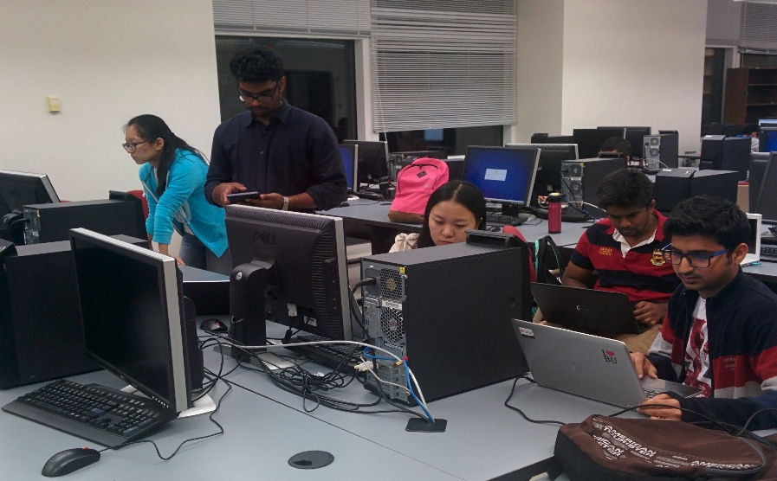
Sprint 2 Jitsi Android Application
By :-
Chuang Ding
Ganesh Seshank
Hitesh Laware
Karunesh Mahajan
Lina Hou
Project Advisor
Professor Osama Alshaykh

Slide 2

Overview of Sprint 1
Learning
Getting familiar with Android studio
Knowing how Web RTC functions
Getting acquainted with tools such as Github, Visual Studio,etc.
Planning
How to go about the app making.
Adding the use cases.

Slide 3
App for Sprint 1
Login and Registering features
Registering a user with basic sign up credentials.
Login using the userId and the password.
Login using Facebook and Gmail account.
Database
Android studio inbuilt database ‘SQL Lite’

Slide 4
Sprint 2 tentative targets decided in Sprint 1
Establish Video Bridge using WebRTC
Integrating cloud backend(Database) with the app
Set up the UI for one-to-one video conference

Slide 5
Sprint 2 Step 1
Establish Video Bridge using WebRTC
Encountered Performance issues

Slide 6
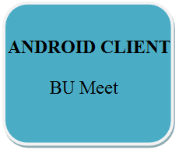
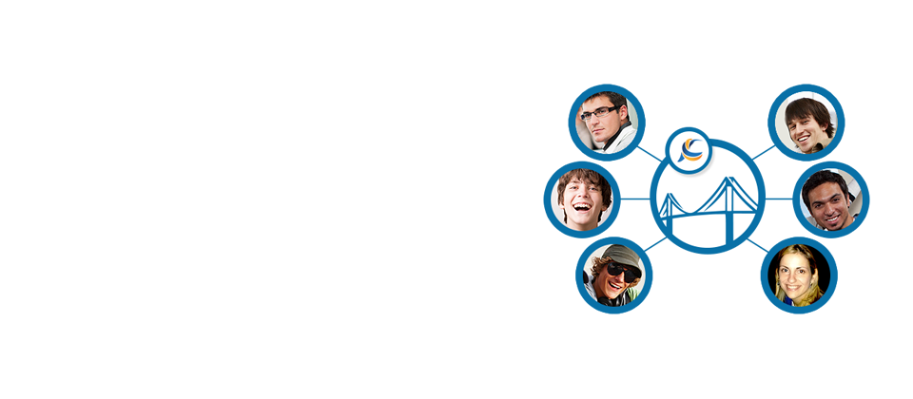

System Architecture
EC2-Instance 1
EC2-Instance 2
BU MEET
SERVICES
Video Call
JITSI MEET
Video Bridge
Data
Exchange
Register User
Login
Add Contact
Delete Contact
RDS
DATABASE
Data
Exchange

Slide 7
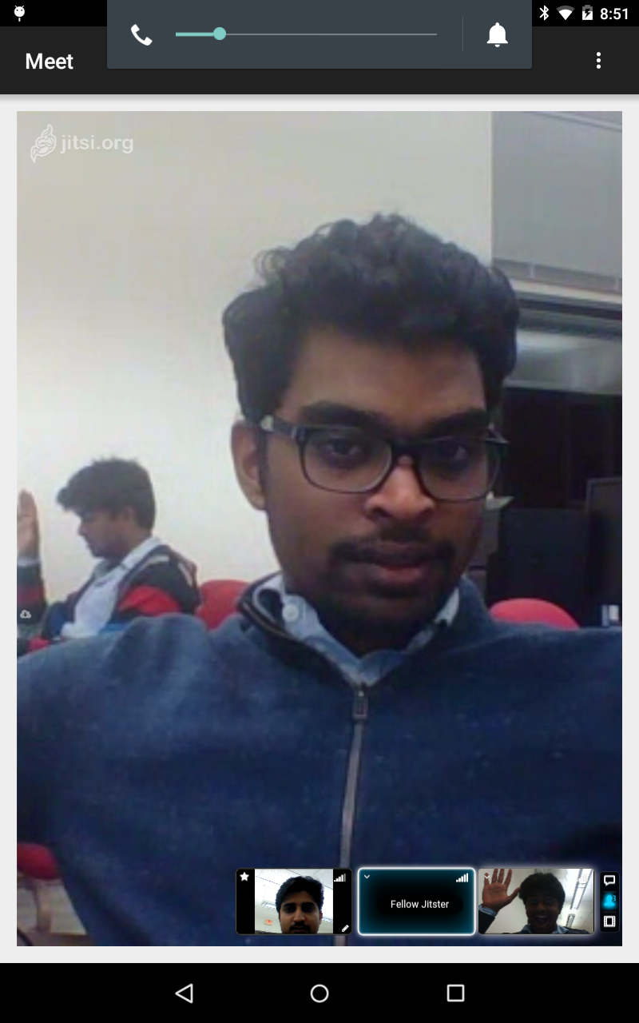
Android Client
Login/Signup module
Integrated

Slide 8
Video Bridge – Jitsi Meet
Jitsimeet Video Bridge was installed and tested in
Server for Video Bridge hosted in Amazon Cloud instance –
nstalled Jitsi Video Bridge in the server.

Slide 9
Challenges Faced
Video glitches in Web RTC video bridge due to division of internet speed.
AWS charging us for using database.
Improvement in Video clarity.

Slide 10
Critical Design Decisions
Using Jitsi Video Bridge instead of Web RTC.
Video Performance
Starting from scratch
Choosing Database host
Reliability
Scalability
Choice of video bridge host.
Video Quality
Global Accessibility

Slide 12

What is Jitsi?
Jitsi (formerly SIP Communicator) is a free and open source multiplatform voice (VoIP), videoconferencing and instant messaging application for Windows, Linux, Mac OS X and Android.

Slide 13

How is Jitsi different from other Videoconferencing Tools
Microsoft (owner of Skype) keeps records of who talked to whom and for how long. We also have very good reason to believe that there are tools out there (built by private companies and sold to governments) that can eavesdrop on Skype voice calls. Skype executives have been unable to deny that they comply with local law enforcement requests to eavesdrop on skype calls.

Slide 14
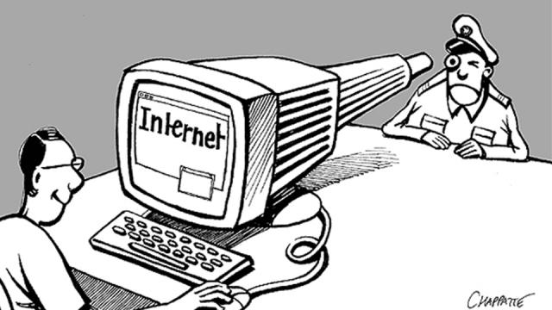
Google definitely record all of your text chats. They don’t deny they do that, even when you use the “Go off the record” option in Google Talk. We’re not sure what recording they do with voice calls but can be certain that they comply with the law – therefore building “legal intercept” capabilities into their products.

Slide 15
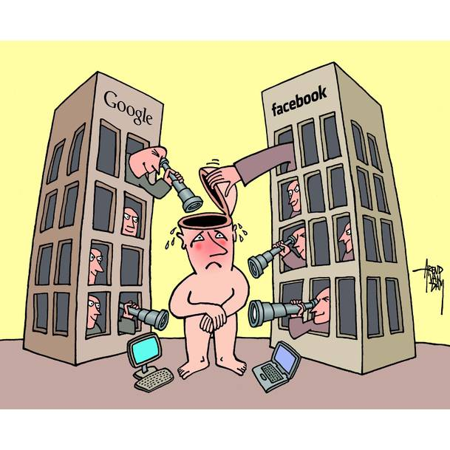
Facebook record and analyze all of your text chats and will report you to the police if they see anything “suspicious” (source: Reuters). We don’t know what they do with voice/video calls, but again can be certain that they comply with the law – therefore building “legal intercept” capabilities into their products

Slide 16
Reasons to switch to JITSI
Because it protects your privacy as much as possible.
Have end-to-end encryption of your voice and video calls – guaranteeing that nobody is listening in or recording.
Have end-to-end encryption of your text (instant messaging) chats with Off The Record (OTR) technology – the world’s finest in preserving your privacy with unique features like Perfect Forward Secrecy and Deniability.
As an additional benefit, it’s great to have all of your instant messaging contacts in one window, and Jitsi gives you that. It also runs on Windows, MacOSX and GNU/Linux.

Slide 17
Our Target
To establish multi user Video Conferencing.
Call encryption.
Other features such as
Desktop streaming
Audio conference calls
Call recording

Slide 18
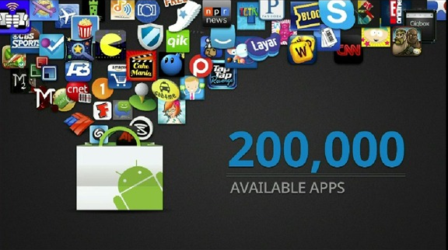

Jitsi Android App
Objective
Develop an android app to enable multi-user video conference using Jitsi Video bridge and WebRTC along with other development tools. Also adding additional functionalities within the app.
Why App if it already works in most of the browsers –
Laptop for web browsers and mobile/tab for Apps
Innovation – adding additional features along with the existing such as file sharing, integrating messaging and conferencing, video recording, etc.

Slide 19


For whom are we building the app ?
Admin User
The user who logs in the app and starts the video conferencing.
Normal User
The user who joins the video conference started by the admin User.

Slide 20
Use Cases for Normal User
I as a user should be able to
signup/login to the app and join the video conference started by an admin user.
mute my microphone, switch off my camera, send in-app messages (private or public), share files, record conference (audio/video) and scroll through the participants video feeds while within the conference.
disconnect from the conference at any point of time.
invite other participants to the video conference.
share my screen with other participants present in the video conference.
minimize the Jitsi App and make use of the other features in the phone while Video conferencing running in the background.
switch between front and back camera.
Additional features for future dev – Suggestions are most welcome !

Slide 21
Use Cases for Admin User
I as an Admin User should be able to
use all the functionalities mentioned in Use Cases for Normal User.
signup/login to the app, establish a video bridge and start a video conference.
invite participants to the video conference.
remove any participant from the video conference.
mute other users microphone and switch off their video feed.

Slide 22

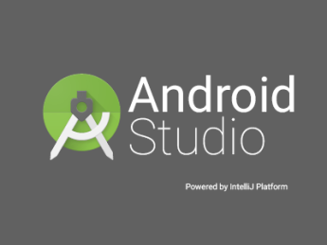

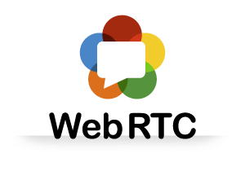



Technologies !

Slide 23
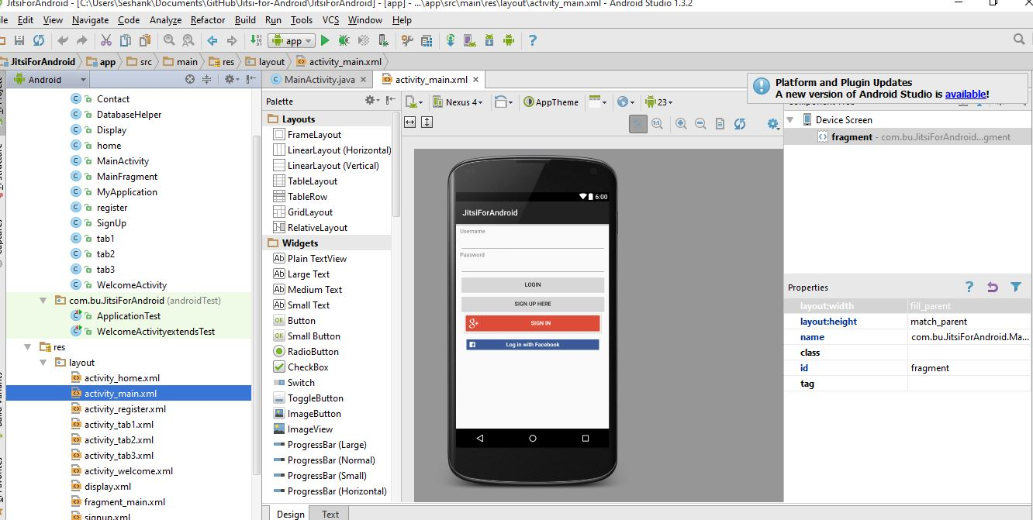
Android Studio

Slide 24
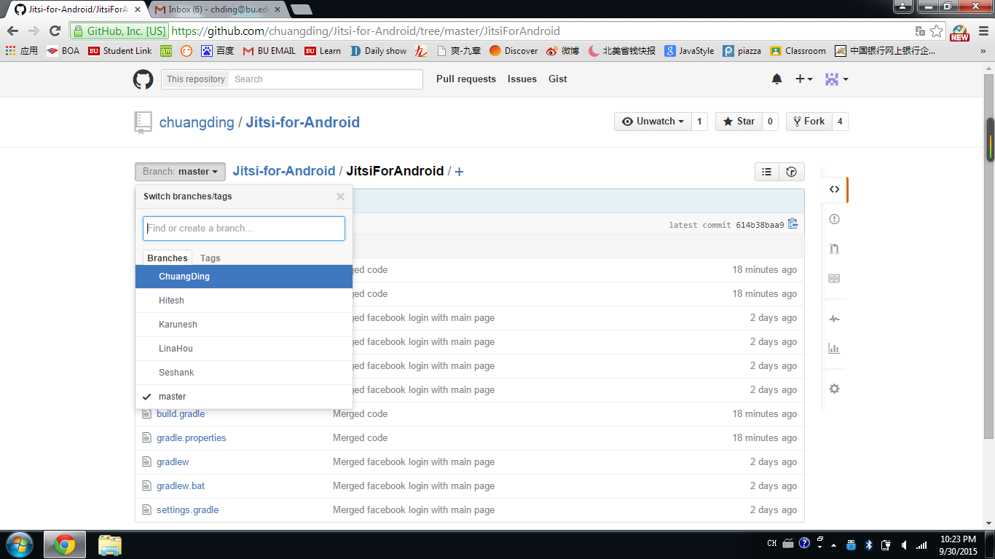
Version Control : Github

Slide 25
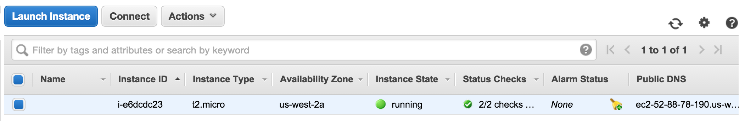
Backend : AWS
Why AWS ?
Has been around for a much longer time than Microsoft azure
S3 provides more than sufficient storage and traffic for our app
No Fee for 12 months

Slide 26
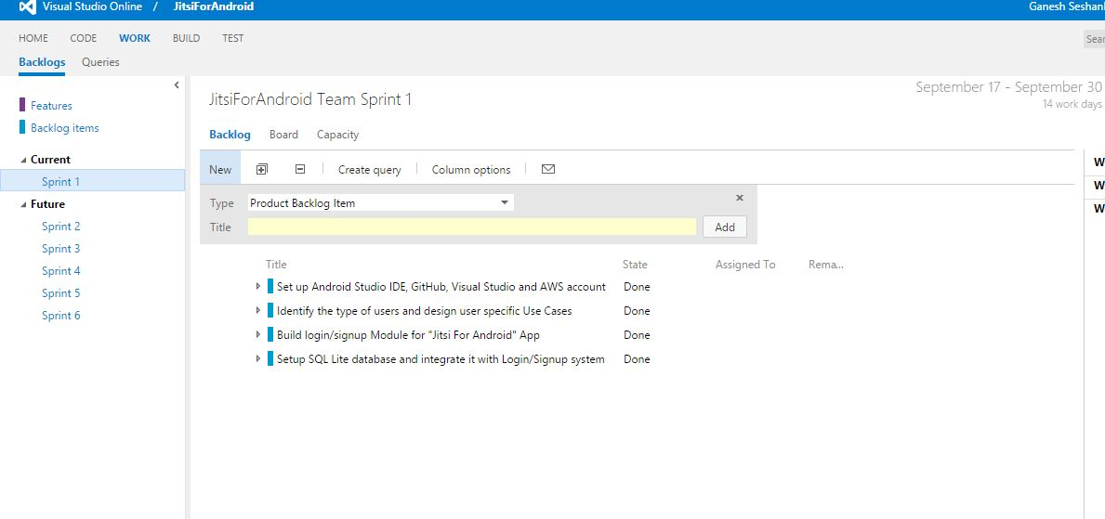
Sprint Tool : Visual Studio

Slide 27
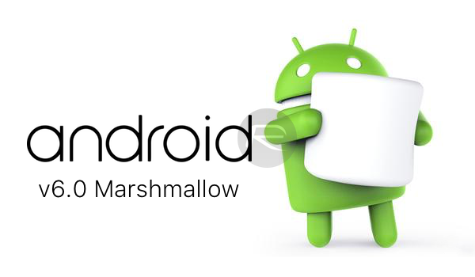
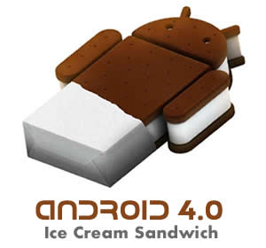

Slide 28
What have we done so far & what is our plan :
Sprint1
Set up Android Studio IDE, GitHub, Visual Studio and AWS account
Identify the type of users and design user specific Use Cases
Sprint2
Establish Video bridge using WebRTC (Jitsi Video Bridge)
Set up UI for 1-1 video conference
Sprint3
Video chat among more than 2 people
Add more features in layout and video chat
Build login/signup Module for "Jitsi For Android" App
Integrating cloud backend with the app
Setup SQL Lite database and integrate it with Login/Signup system

Slide 29
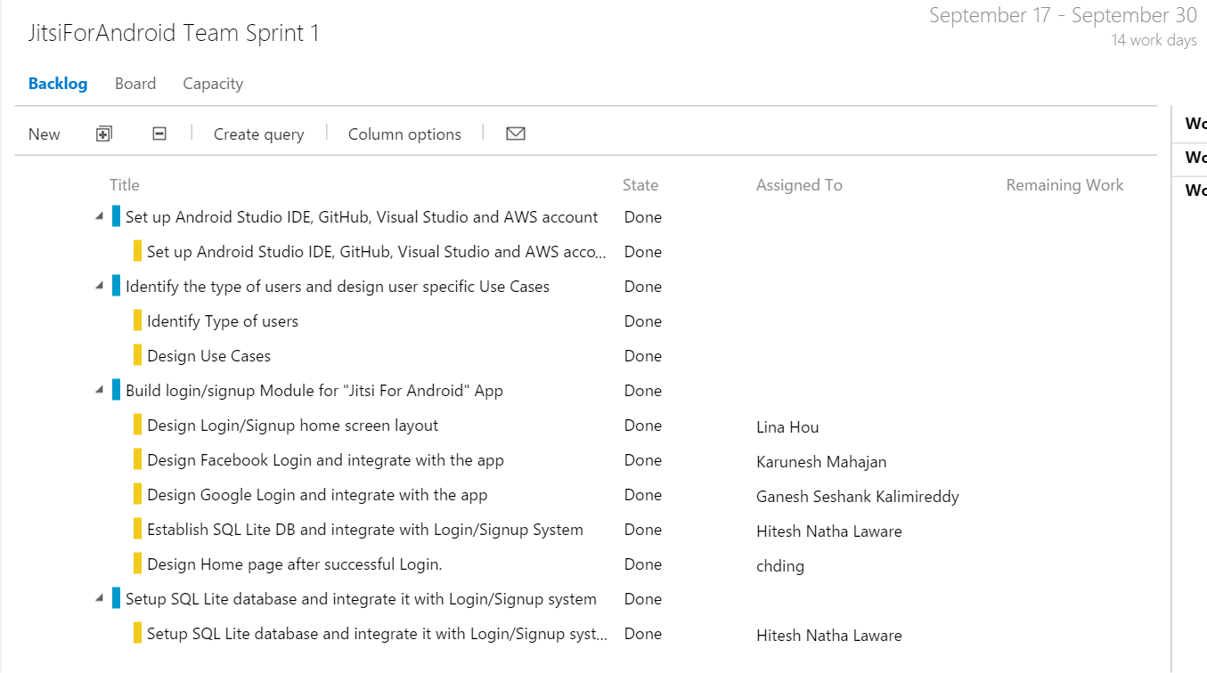

Sprint 1 Flow

Slide 30
Sprint 2 (Tentative)
Establish Video Bridge using WebRTC
Integrating cloud backend(Database) with the app
Set up the UI for one-to-one video conference

Slide 31
App Demo :
Facebook and google accounts are already configured in this mobile, if otherwise then these logins direct to Facebook/Google login page for authentication.

Slide 32
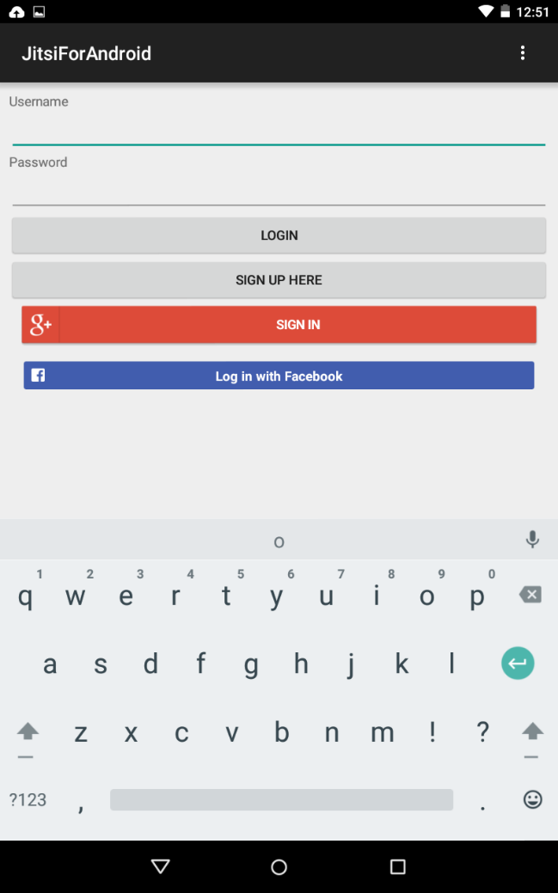
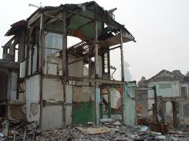
User Interface
Where we are currently

Slide 33
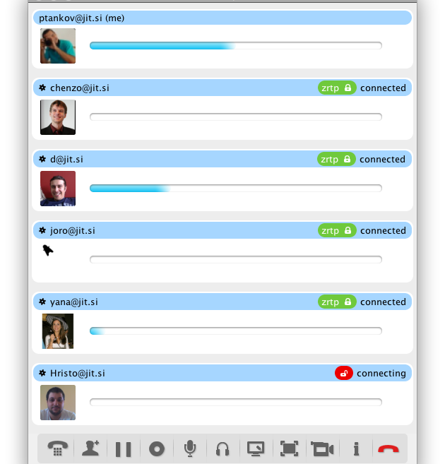
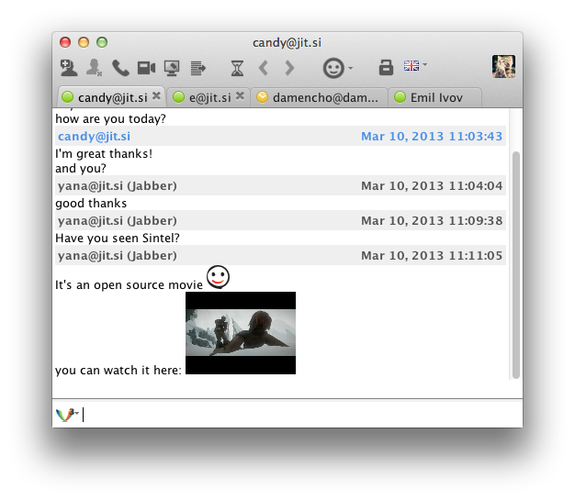
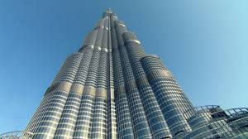
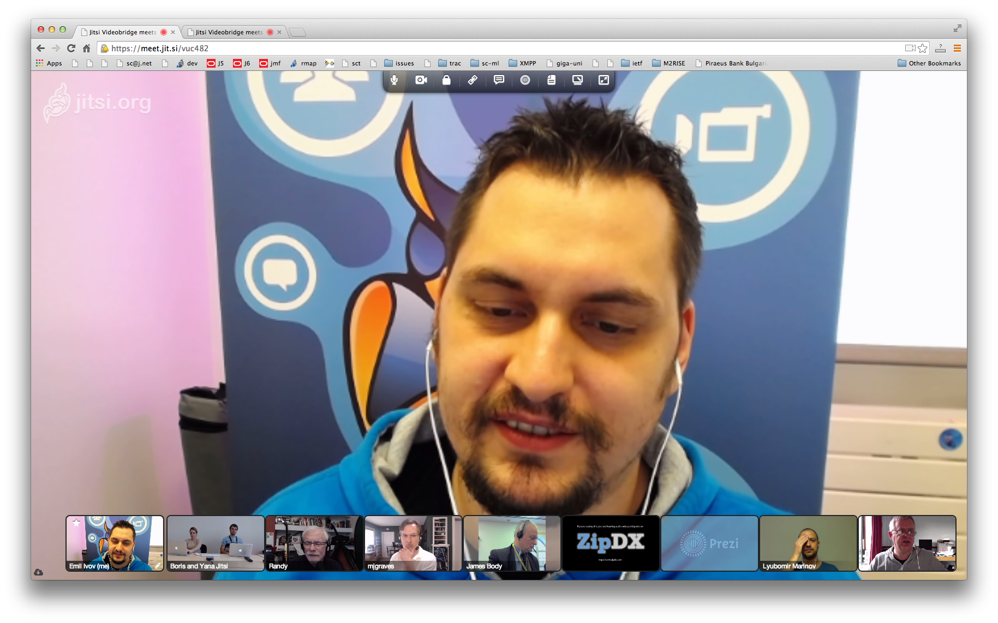
What our target is hi

Slide 34
Thank you !
Q&A

